Slide 1

משפט פתיחה - כאב
7 in 10 Americans
Sitting on unused Cash Back, Points or Miles

Slide 2
Sitting on unused Cash Back, Points or Miles
7 in 10 Americans
Over $100B

Slide 3

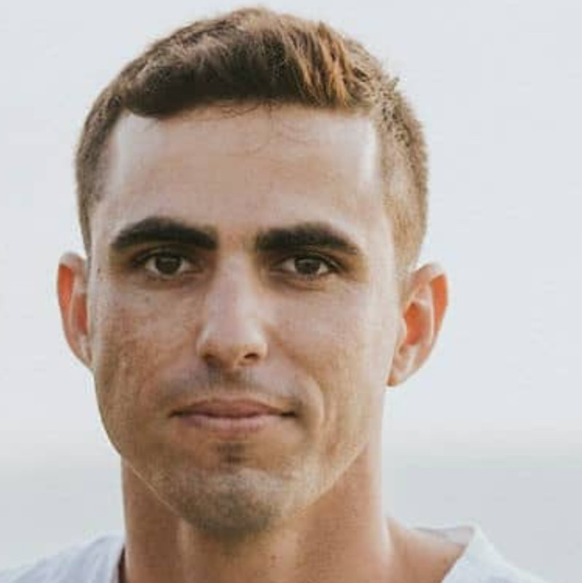



Who we are
Yuval Ofek Software Developer @ AT&T, 3rd year Computer Science student.
Dan Davidovich
Officer in Flotilla 13 with the rank of major, 3rd year Computer Science student.
Idan Asayag Frontend Developer @ Elta Systems Ltd, 3rd year Computer Science student.
Omer Ben David Software Developer @ IDF, 3rd year Computer Science student
Lior Hassin 3rd year Computer Science student.

Slide 4
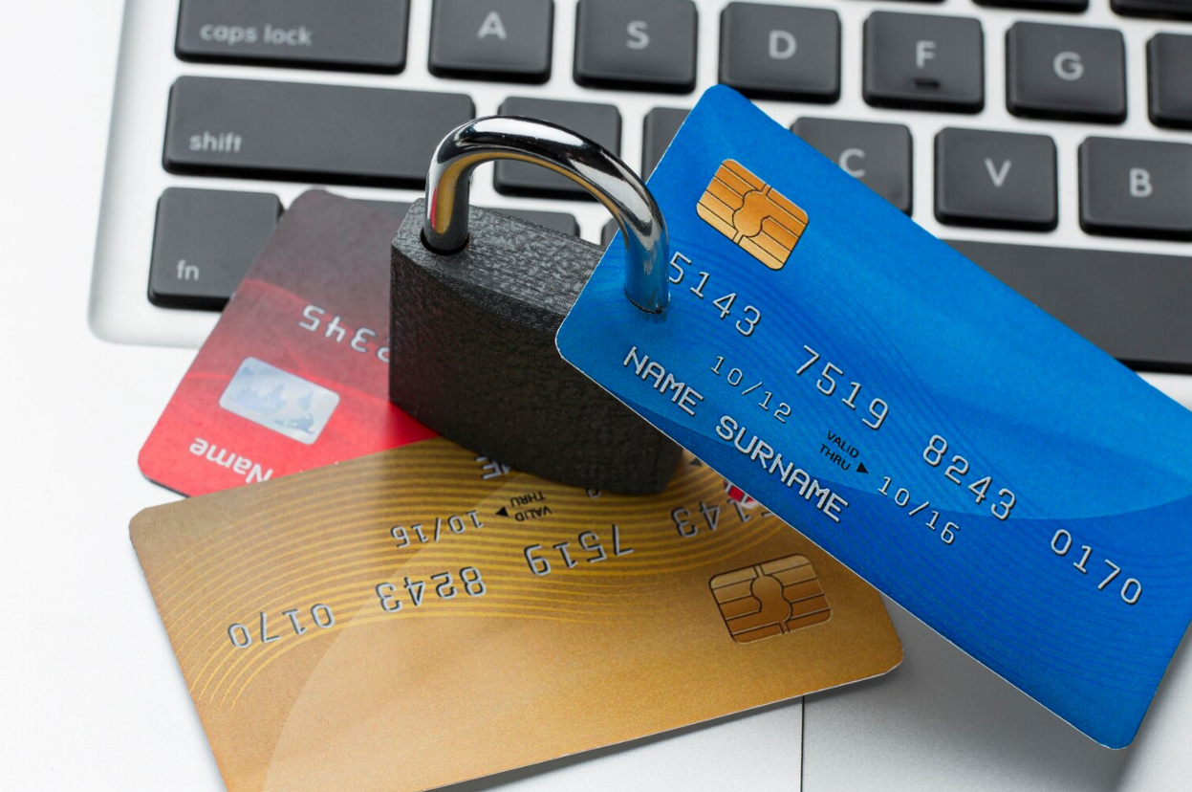
Of US residents hold at least 1 credit cards (3 in average).
haven’t cashed in on any rewards in the past year
82%
40%

Slide 5
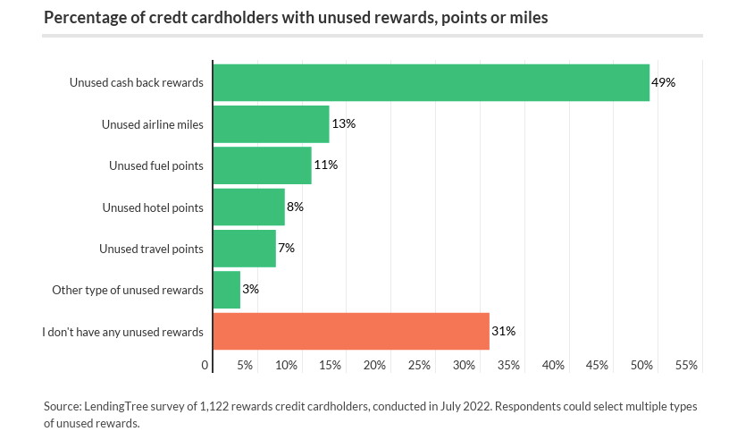

Slide 6

John
Mileage for a free flight from NYC to Miami

Slide 7



John
Mike’s family
Mileage for a free flight from NYC to Miami
Flight from NYC to Miami

Slide 8
John
Mike’s family
Win
Win
Mileage for a free flight from NYC to Miami
Flight from NYC to Miami

Slide 9


Slide 10


Meet BenfiTrade
Making your benefits worth money

Slide 11






Rewards Market
Users can list their unused points, miles, and perks from various loyalty programs for sale.
Buyers can browse available rewards, filter by program, and purchase what best suits their needs.
A real-time pricing mechanism adjusts the value of points and miles based on supply and demand, similar to a stock market. This ensures fair and transparent pricing.
Transactions are secure, with a built-in block-chain system that ensures the transfer of points or miles only occurs once payment is confirmed.
There is a transaction fee of 0.5% and subscription fee of $2 per month.

Slide 12




Total Available Market
69% of American cardholders sitting on unused rewards
188,411,400 people
Monthly subscription fee of $2 + 0.5% commission fee
=>
Over $4.5B yearly

Slide 13

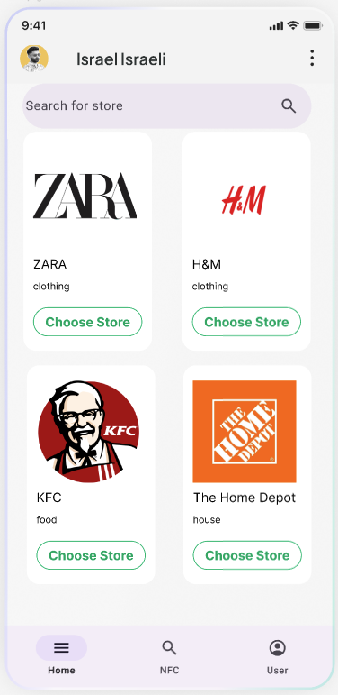


How does it work?
The app will keep the data of benefits within credit cards (both general benefits and specific benefits between credit card to business).
The users can select their preferences (Nominal profit, Lowest price or points, and arrange their preferred cards in a list).
The customer will enter the business name and the transaction amount - and the algorithm will sort the cards from the most profitable to the lowest.
The app includes a premium account with unlimited cards, unlimited recommendation usage, and no ads.

Slide 14
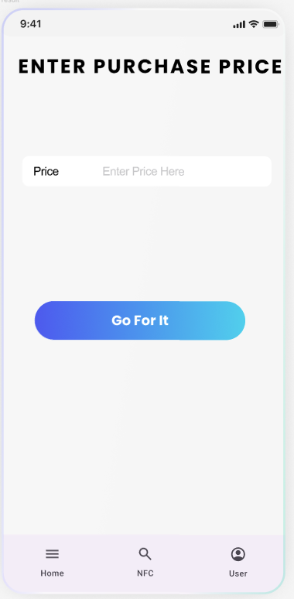
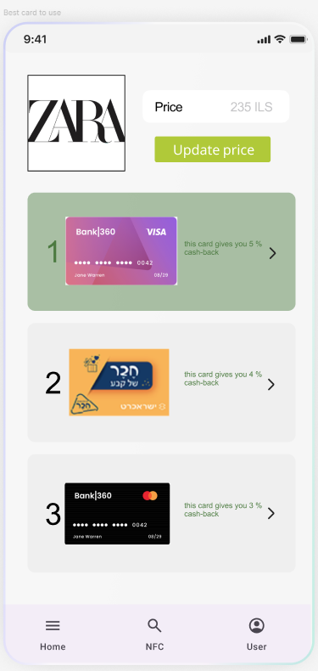

How does it look?

Slide 15
Competition
Brokers that helps people to sell their miles and points - it is unsecure (some of them get the points without paying the seller.

Slide 16
Funding Request
We ask for $2M R&D: $1 Million (50%) – Employees • App development • Security
S&M: $500K (25%) – Branding • Designing • PR• Studio Expenses G&A: $500K (25%) – IT • Development licenses • Cloud services• Legal• Rental funding will sustain operations for 2 years projected outcome: 20K paying customers expected revenue: $40,000/month ($480,000/year)

Slide 17
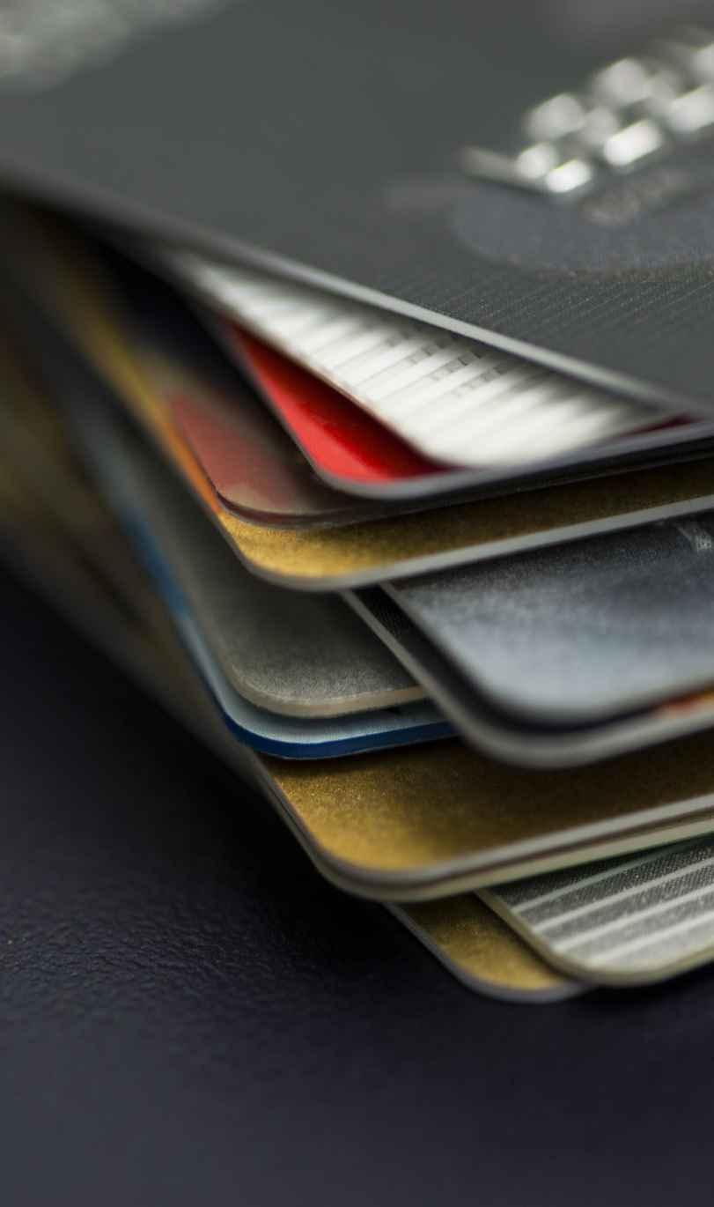
Market
In 2023, the scope of spending on credit cards in the Israeli economy reached an amount of more than NIS 465.987 billion, an increase of 5.22% compared to 2022. Spending in online transactions on Israeli websites reached 267.406 billion NIS.
About 75% of israelis possess more than one credit card - amounts to approximately 7.381 million people.
2.5 is the average number of cards for every person who uses credit cards.
Around 56% of Israeli credit card holders reported actively using the rewards associated with their credit cards.
*How Do Consumers Feel About Credit Cards?

Slide 18

Join us in our mission to help millions turn their benefits into money.

Slide 19
As of 2023, 75% of Israel residents hold at least two credit card with an average spends of 150,000 per year.
What if I can save you with a 7 seconds at the
7 מתוך עשרה יכולים לחסוך כ3000 שח בשנה ללא כל מאמץ
Isracard

